Slide 1
AI Assignment

Slide 2
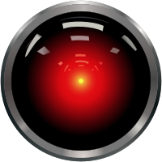
Brief Summary
“The Impact of AI”
Videogame, Digital Animation or Physical Game
16-25y/o Target Audience
Deadline 26th April, Just over 2 months

Slide 3
What is AI?
AI can mean 2 different things
Science Fiction Concept
A computer that has human-like sentience and can experience the world in a subjective way.
Interesting Narrative Idea
However, in games, AI can also mean the behaviour of the Non-Player Characters that you interact with.
Enemies, Friendly characters, Animals

Slide 4
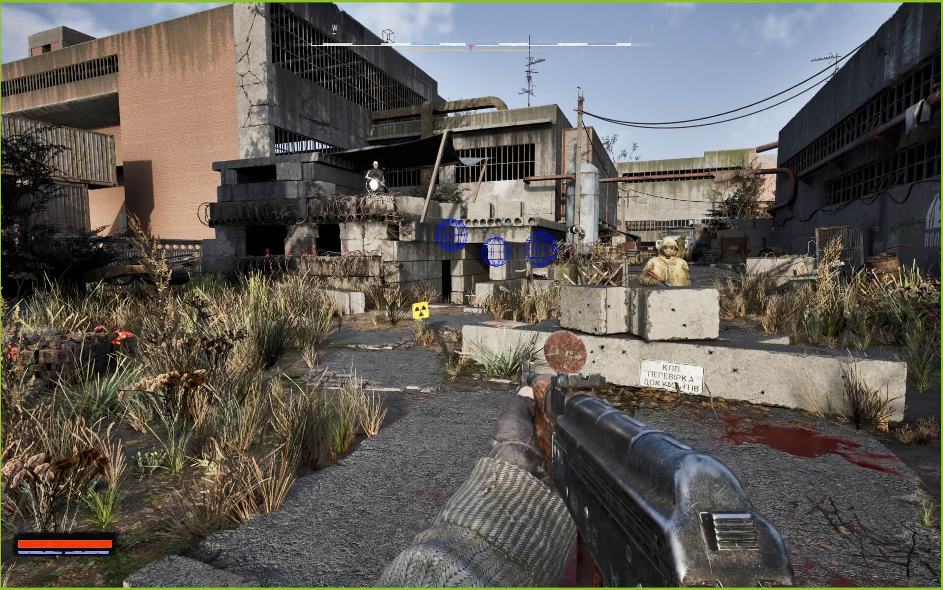
Idea 1: Silent Strike / Silent Rush
Realistic, Tactical First Person Shooter
Inspired by games such as Escape from Tarkov, the STALKER series, and the ArmA series.
Set in a fictional Eastern European country, during a civil war. You play as the insurgents and must clear out different military camps and towns.
There will be AI enemies that take defensive positions in cover, and their spawn positions will be randomly selected from multiple preset locations.
You will also have a simple AI teammate that you can order to give suppressing fire on a certain location, watch your back, or help you clear rooms by throwing flashbang grenades.
At the start of the scenario, you can choose from a few infiltration locations, and once you have cleared the area/seized the objective, you need to exfiltrate on the other side of the map.

Slide 5
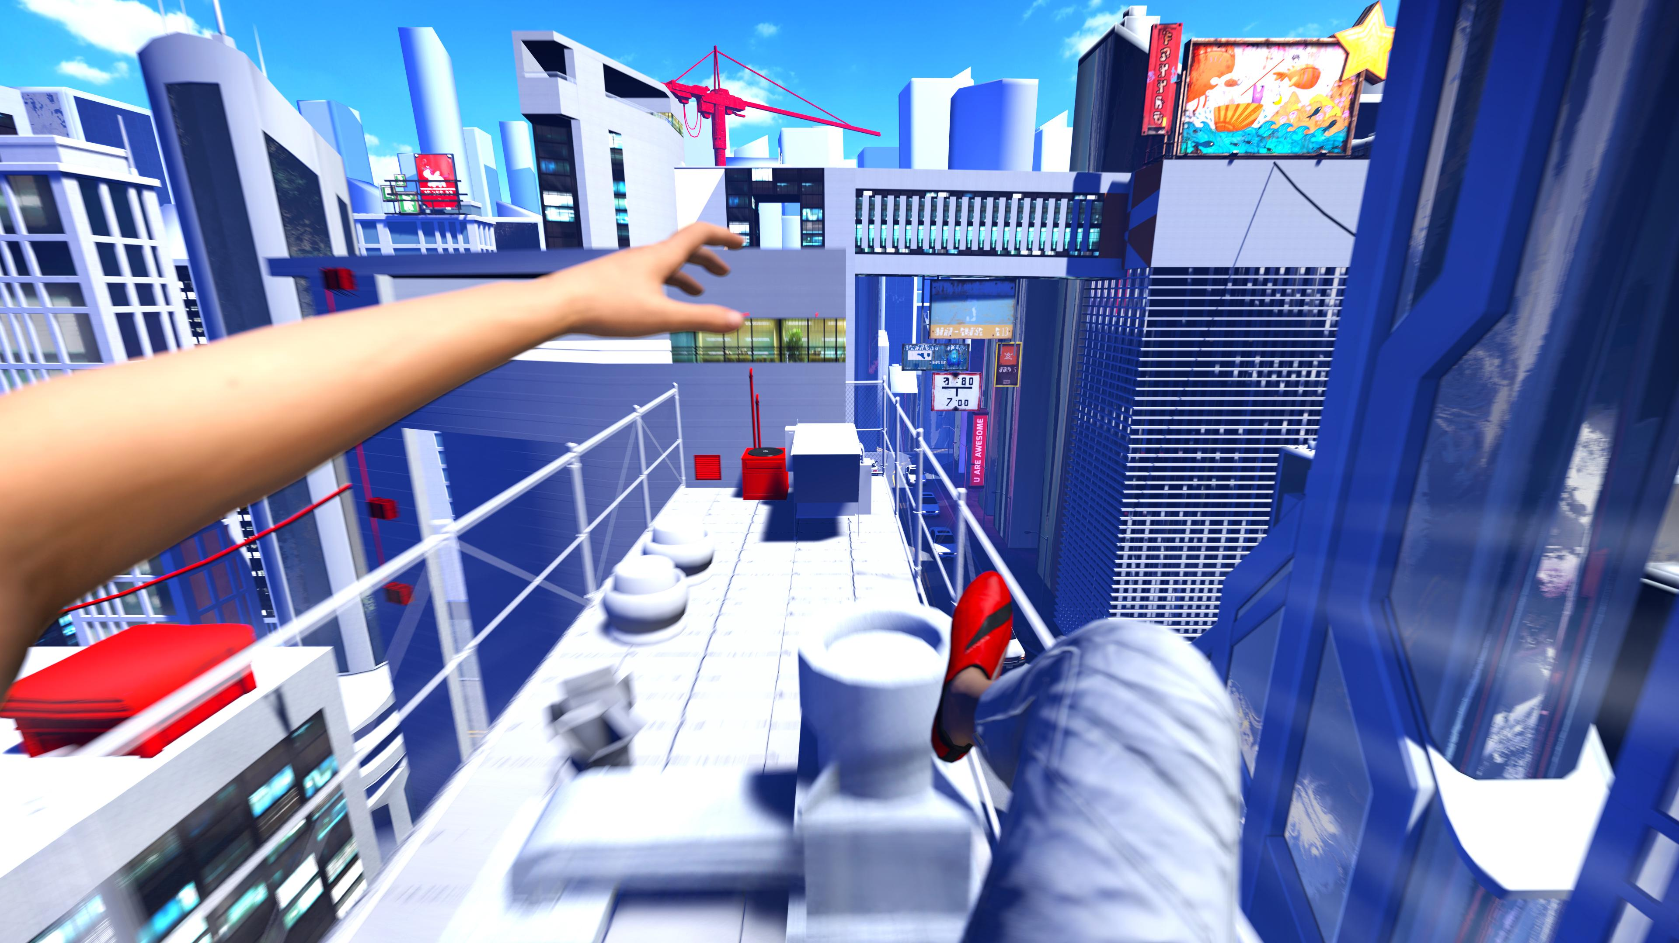
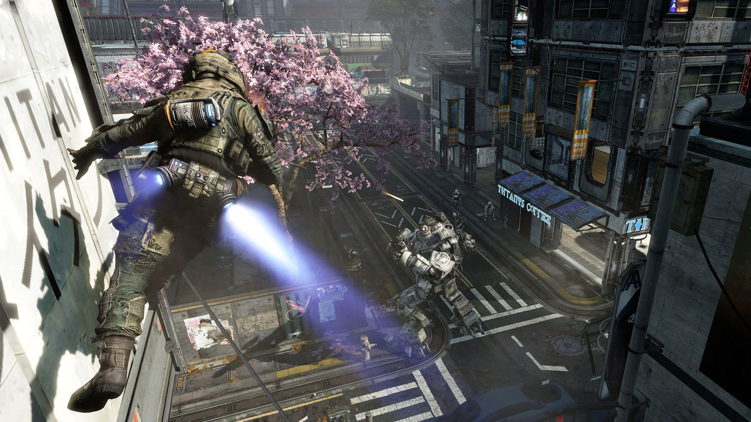
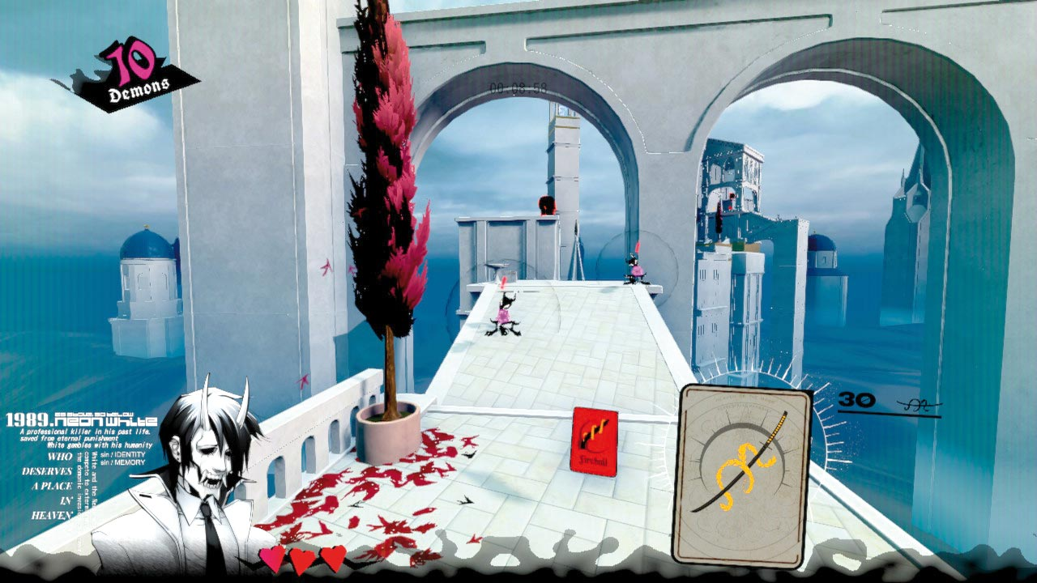
Idea 2: Movement Shooter
Futuristic Movement Shooter
Inspired by Titanfall 2 and the Mirror’s Edge franchise, and Neon White
You need to enter the core of an evil AI, destroying different sections of it along the way, as it sends hostile androids to try and stop you.
Wall running, grappling hooks, and bunny-hopping with high weapon accuracy in every circumstance
You get a score based on the time you completed the stage, as well as your accuracy and how many targets you missed.
Large, semi-linear maps to encourage replaying the maps and finding faster routes

Slide 7
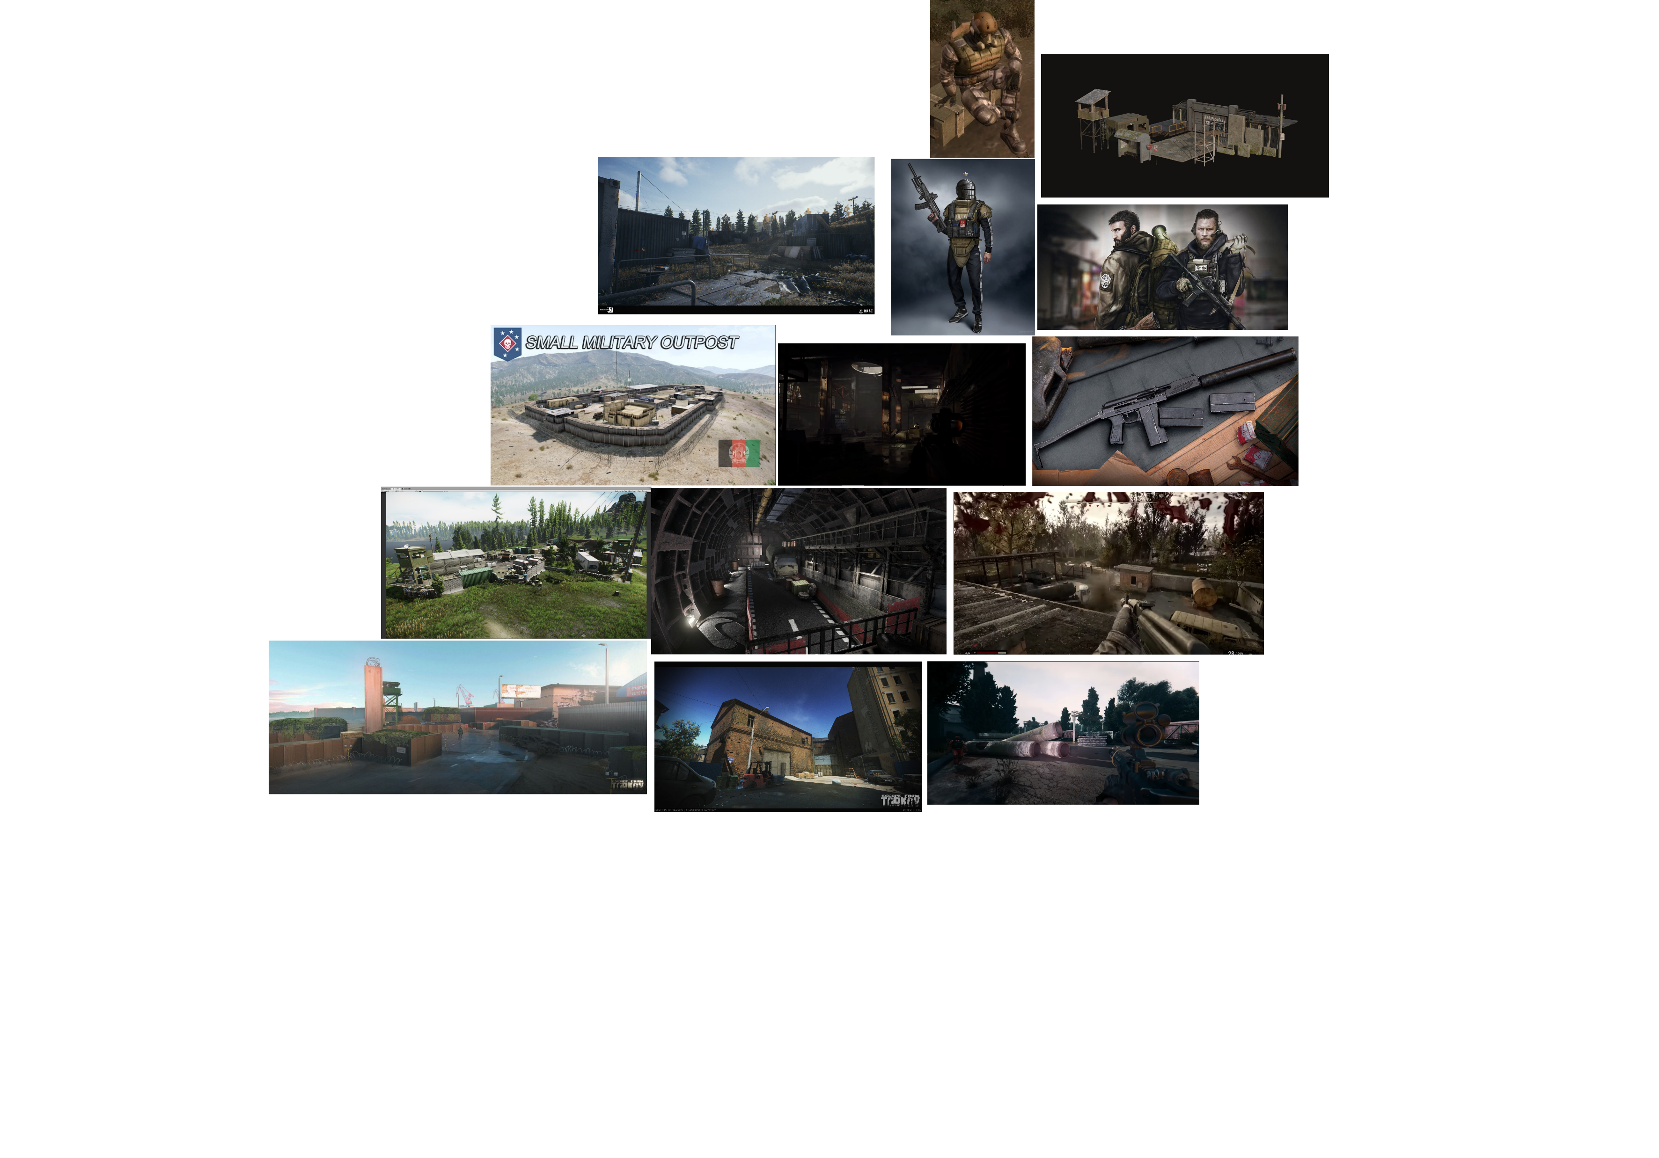
My Choice
I chose to continue with my first idea, Silent Strike.
This is because I think I would find it interesting to code realistic bullet physics and weapon inaccuracy
It also means I will have to create 2 different types of AI, enemy and friendly.
I also play these tactical shooters a lot and it is my favourite genre.
I created a Moodboard to help pin down the visual style I was going for.

Slide 8
Conclusion
My Minimum Viable Product would be a functional First Person Shooter with movement and functional weapons (including reloading, aim-down-sights, etc.), and one or two maps that have defensive enemy AI
My Unique Selling Point is that there aren’t many single-player or co-op tactical shooters, they are usually Player v Player Multiplayer.

